Slide 1
Continuity testing – protective conductors
PowerPoint presentation
Unit 304: Electrical Installations: inspection, testing and commissioning

Slide 2
Factors that affect conductor resistance values
A number of factors will affect the resistance of conductors and these will have been dealt with in electrical science. However, it is worth mentioning them again here.
Cables connected in parallel: Connecting cables in parallel will have the effect of reducing the overall resistance which can be calculated using the resistors in parallel calculation that you would have covered in electrical science.
For example, if two cables of resistance 0.8Ω and 0.5Ω are connected in parallel, calculate the overall resistance of these two cables.
R = Reciprocal(Reciprocal(0.8) + Reciprocal(0.5))
= Reciprocal(1.25 + 2)
= Reciprocal(3.25)
= 0.31Ω

Slide 3
Factors that affect conductor resistance values
A number of factors will affect the resistance of conductors and these will have been dealt with in electrical science. However, it is worth mentioning them again here.
Variations in cable length: As was seen in electrical science, the resistance of a cable is directly proportional to its length.
Put simply if we double the length of a conductor we double its resistance.
Conversely, if we half the length of the cable we half its resistance.
We need to consider this aspect when determining if a cable complies with requirements as long cable runs will have higher resistances.

Slide 4
Factors that affect conductor resistance values
A number of factors will affect the resistance of conductors and these will have been dealt with in electrical science. However, it is worth mentioning them again here.
Variations in conductor cross sectional area: Remembering what was also covered in electrical science, the resistance of a cable is indirectly proportional to its cross sectional area;
if we double the cross sectional area of a cable we half its resistance and vice versa.

Slide 5
Continuity of protective conductors
The initial tests applied to every protective conductor, including main earthing conductor, main and supplementary bonding conductors, are carried out for two purposes:
To verify that the conductors are both correctly connected and electrically sound;
To provide a measure of (R₁+R₂) to verify that the overall earth fault loop impedance of the circuits is of a suitable value.

Slide 6
Continuity of protective conductors
Instrument to be used:
An ohmmeter capable of measuring a low resistance should be used for these tests.
It is recommended that the test be carried out with a supply having a no-load voltage between 4 volts and 24 volts – d.c. or a.c. – and a short-circuit current of not less than 200mA (Regulation 612.2.1 – page 199).

Slide 7
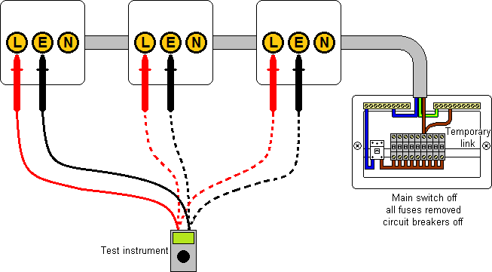
Continuity of protective conductors
Test method 1
Bridge the line conductor to the protective conductor at the fuse-board and test between line and earth terminals at every appropriate point in the circuit under test as shown below:

Slide 8
Continuity of protective conductors
A low reading should be expected to show that the conductors are continuous as any breaks in either conductor will result in a high or ‘over range reading.
The reading obtained at the furthest point of the circuit will be the measured value of (R₁ + R₂) and should be inserted into the relevant column in the Schedule of Test Results.
This reading should be compared with the calculated value of (R₁ + R₂) obtained by using Table I1 in the On Site Guide.

Slide 9
Continuity of protective conductors
For example, a twin and cpc cable with copper conductors has a line conductor with a csa of 2.5mm² and a cpc conductor with a csa of 1.5mm² and is twenty metres long. Calculate the (R₁ + R₂) for this cable at 20ºC.
Factor for cable with 2.5mm² line and a 1.5mm² cpc = 19.51mΩ/m
(R₁ + R₂) = 19.51 x 20 / 1000
= 0.39Ω
You measured value should be somewhere close to the calculated value and in this case, a reading of 0.3 to 0.5Ω would be acceptable.

Slide 10
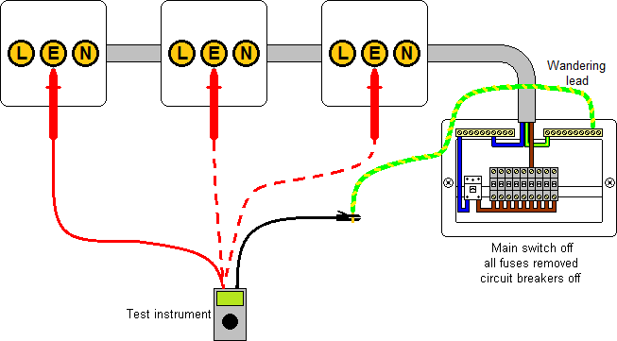
Continuity of protective conductors
Test method 2
One lead of the test instrument is connected to the earth terminal at the distribution board via a length of test cable or ‘wander lead’. The other test lead is used to make contact with the protective conductor at various points on the circuit under test as shown below:

Slide 11
Continuity of protective conductors
The resistance of the wander lead and test leads are either auto-nulled prior to making the test or measured and subtracted from measured readings.
A low reading should be expected to show that the conductor is continuous as any breaks in the conductor will result in a high or ‘over range reading.
The reading obtained at the furthest point of the circuit will be the measured value of R₂ and should be inserted into the relevant column in the Schedule of Test Results if required.
This reading should be compared with the calculated value of R₂ obtained by using Table I1 in the On Site Guide.

Slide 12
Continuity of protective conductors
For example, cpc cable with copper conductors has a csa of 2.5mm² and is twenty five metres long. Calculate the R₂ for this cable at 20ºC.
Factor for cable with 2.5mm² cable = 7.41mΩ/m
R₂ = 7.41 x 25 / 1000
= 0.19Ω
You measured value should be somewhere close to the calculated value and in this case, a reading of 0.1 to 0.3Ω would be acceptable.
For both Test Method 1 and Test Method 2, if the measured reading is significantly higher it may indicate faulty conductor termination at some point during the circuit.

Slide 13
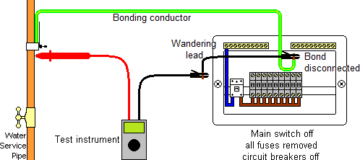
Continuity of protective conductors
Testing bonding conductors and earthing conductors
When the continuity of bonding conductors is carried out use Test Method 2.
To avoid getting lower readings due to possible parallel paths, one end of the bonding conductor should be disconnected whilst the test is being carried out.

Slide 14
Any questions?

